Slide 1
Accessing a Semantic Graph Database with OpenUI5 via OData
by Andy Le, Sebastian Faubel, Moritz Eberl, Stefan Summesberger

Slide 2
Agenda
About the presenters
Introduction to Linked Data
COVID-19 Use Case
Live Demo
Demo: Technical Background
Conclusion

Slide 3
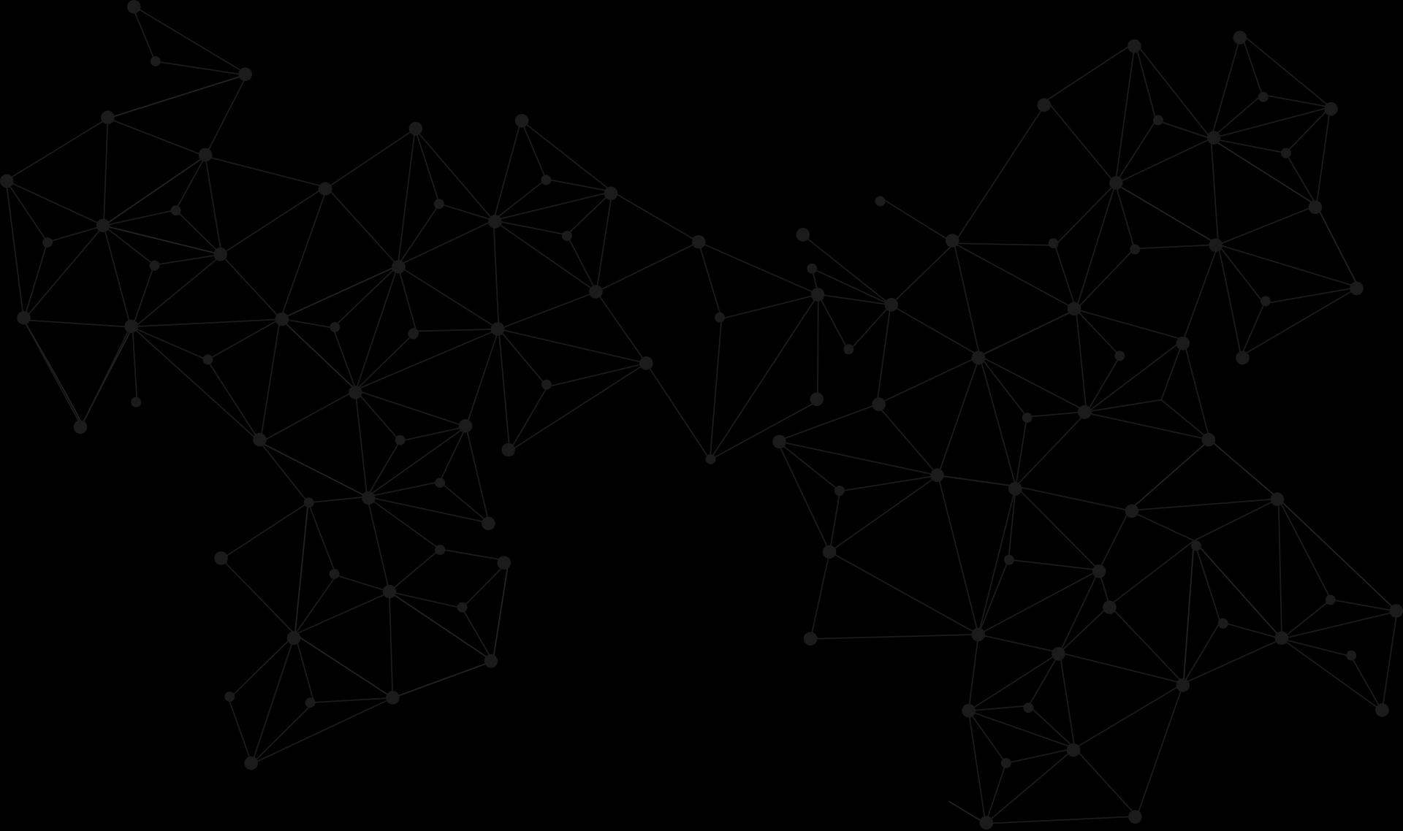
About the Presenters.

Slide 4

ABOUT THE PRESENTERS
Andy Le
Recently graduated from Sheffield Hallam University
Worked on an R&D project concerning IoT and the Semantic Web for indoor tracking as part of my internship for Airbus contractor Geometric Europe.
Investigated in Object-Mapping for Graph Databases and their usage in industrial use cases for business process automation for my Bachelor project and two corporate clients.
How did I meet Semiodesk?
Contacted them during a research activity at my internship.
Gained their support on Trinity RDF throughout my Bachelor project.
Strategy gamer, travel addict and meme enthusiast in real-life.
www.linkedin.com/in/andyle13

Slide 5




ABOUT THE PRESENTERS
Semiodesk provides know-how and efficient tools to speed up the development of enterprise knowledge graph applications
Moritz Eberl
Co-Founder
Sebastian Faubel
Co-Founder
Stefan Summesberger
Head of Business Development

Slide 6

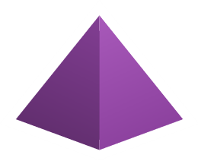
ABOUT THE PRESENTERS
Our Products
modom.io
Trinity RDF
Easily create well-documented ontologies and turn them into ready-to-use software packages. https://modom.io
Enterprise ready object mapper for developing RDF knowledge graph applications with .NET.
https://trinity-rdf.net

Slide 7
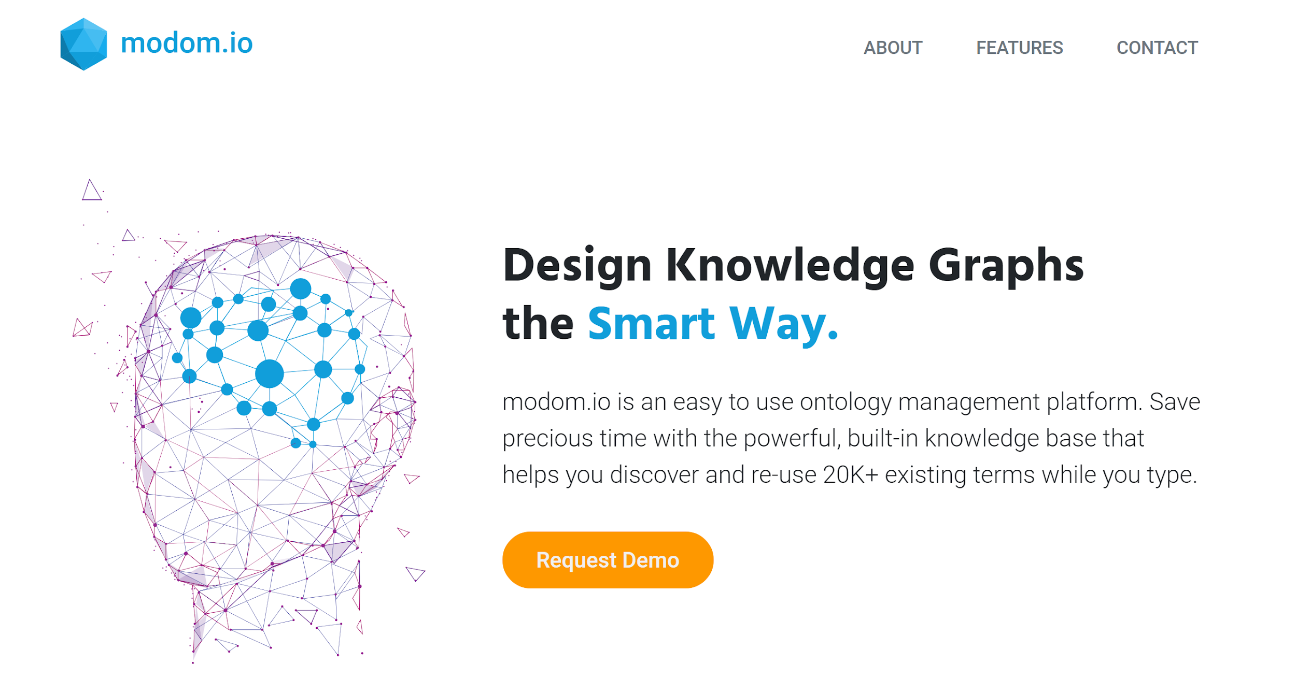
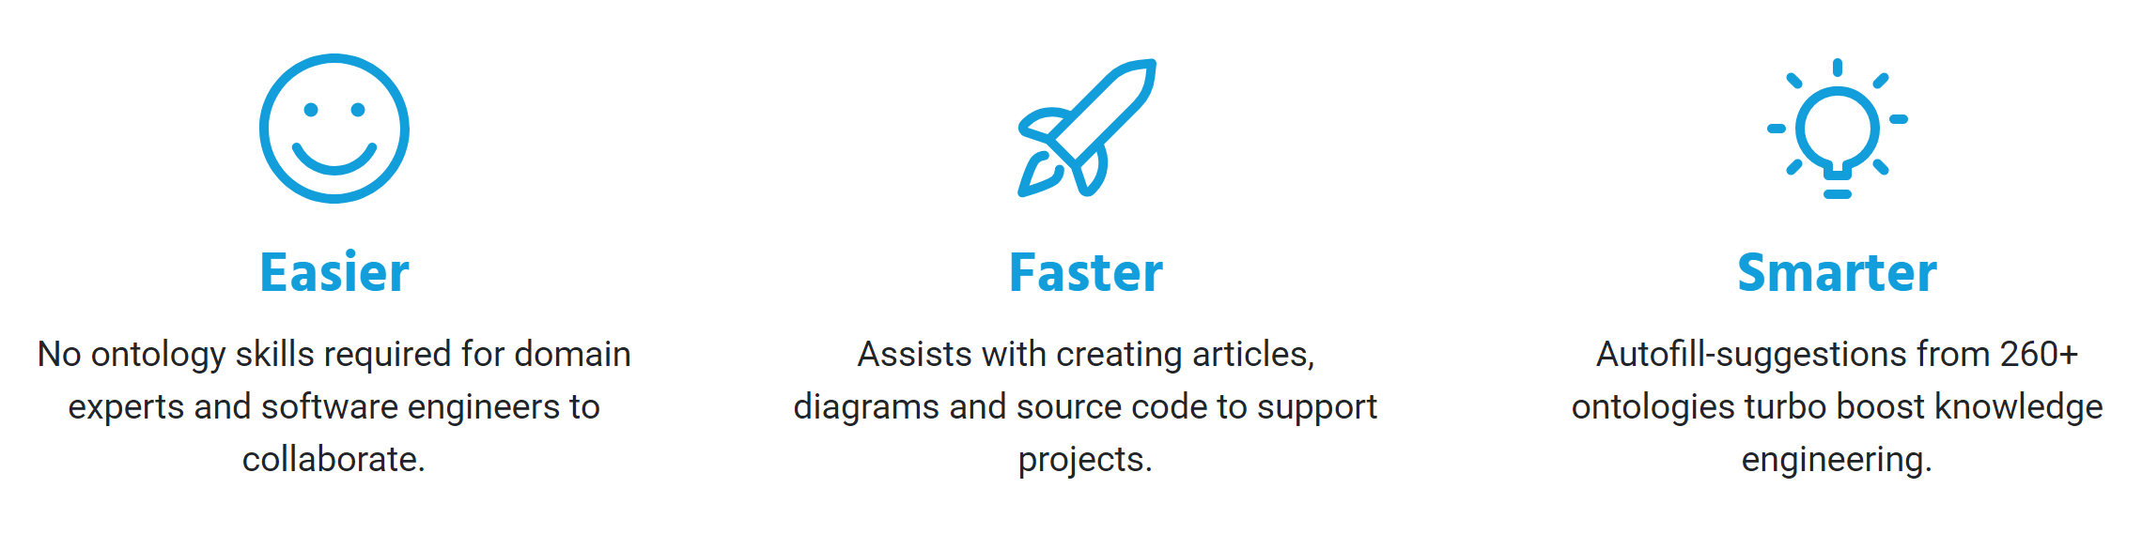
https://modom.io
©2020 Semiodesk GmbH, Germany. All rights reserved.

Slide 8

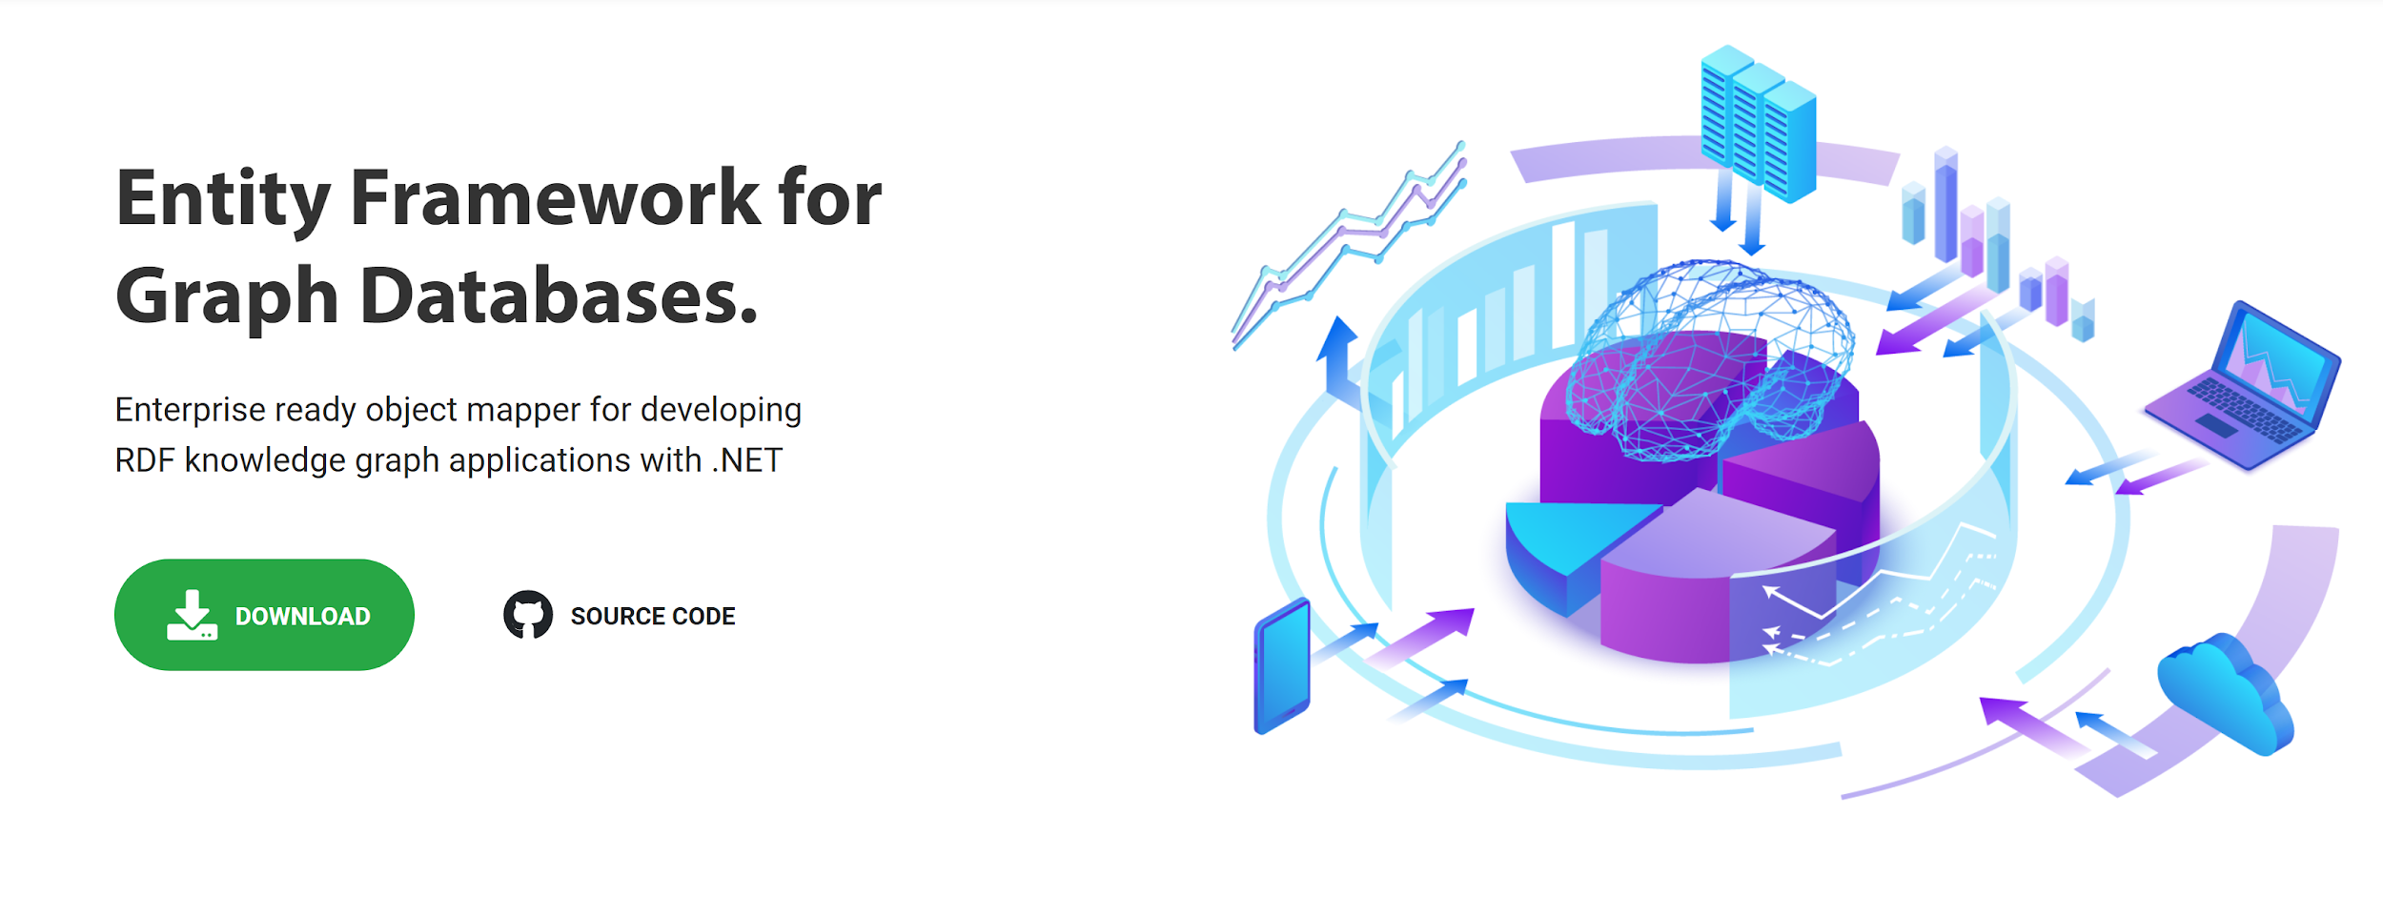
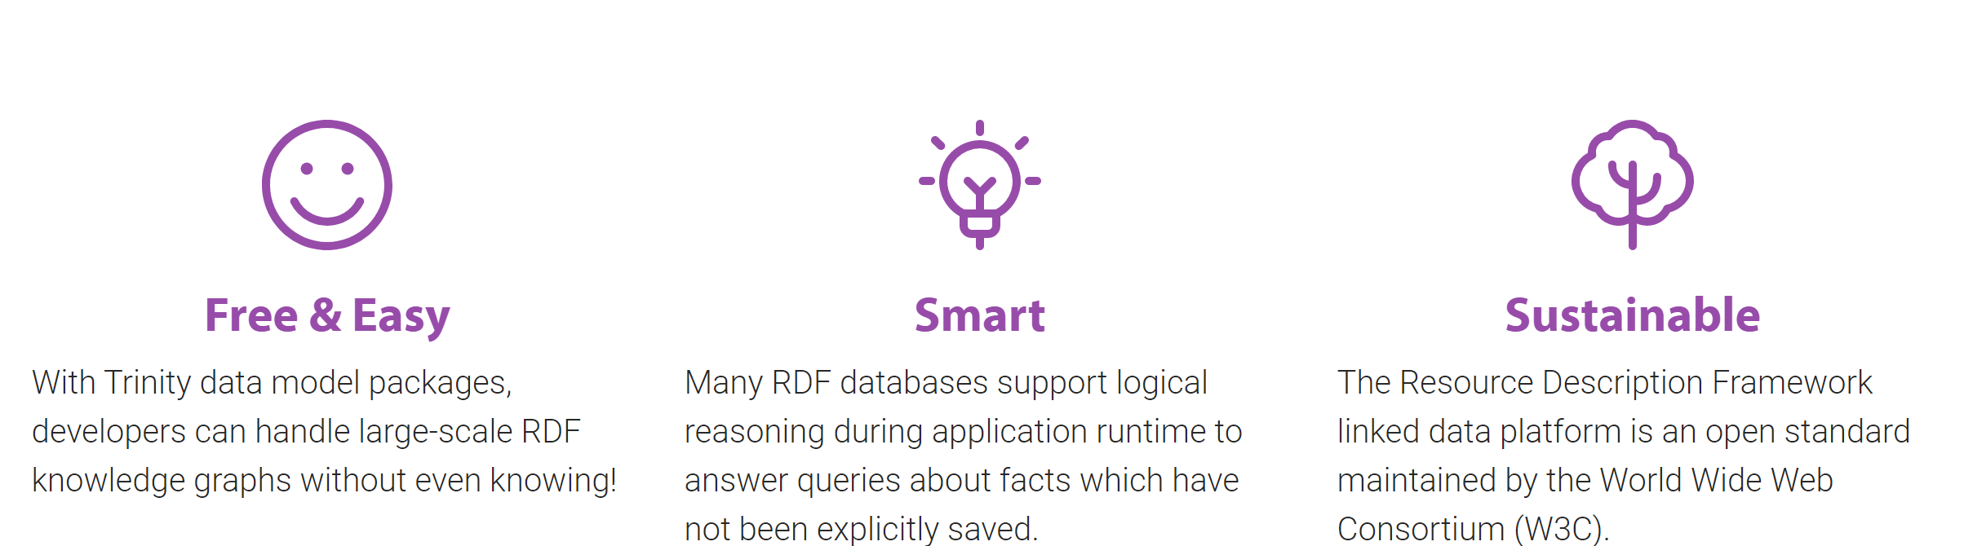
https://trinity-rdf.net
©2020 Semiodesk GmbH, Germany. All rights reserved.

Slide 9
Introduction to Linked Data.

Slide 10
INTRODUCTION TO LINKED DATA
What is Linked Data?
Subject
Predicate
Object
:is a
:Andy
:Person
At the heart of linked data is a sentence.
It’s also called Triple.

Slide 11
INTRODUCTION TO LINKED DATA
What is Linked Data?
Subject
Predicate
Object
:is a
:Andy
:Person
:first name
‘Andy’
:last name
‘Le’
The object of a triple is either a literal value such as a name..

Slide 12
INTRODUCTION TO LINKED DATA
What is Linked Data?
:is a
:Andy
:Person
:is a
:is a
:Sebastian
:Stefan
..or another subject, such as another person.

Slide 13
INTRODUCTION TO LINKED DATA
What is Linked Data?
:Laura
:Robert
:has met
:has met
:Andy
:Andy
:Anna
:has met
:has met
:has met
:has met
:Sebastian
:Sebastian
:Stefan
:has met
:Stefan
:Moritz
..as we add more links to other people..

Slide 14
INTRODUCTION TO LINKED DATA
What is Linked Data?
..we create a social network / graph.

Slide 15
INTRODUCTION TO LINKED DATA
What is a Graph Database?
A database which is optimized for:
Storing and querying linked data
Finding interconnections in data
Scalability
W3C Graph Database Standards:
RDF / RDF* Linked Data Format
SPARQL Query Language

Slide 16
INTRODUCTION TO LINKED DATA
Who is using Graph Databases?
 | Company name | Location | Industry | Market Cap Change 2009 - 2018 ($bn)
1 | Apple | United States | Technology | 757
2 | Amazon.Com | United States | Consumer Services | 670
3 | Alphabet | United States | Technology | 609
4 | Microsoft Corp | United States | Technology | 540
5 | Tencent Holdings | China | Technology | 483
6 | Facebook | United States | Technology | 383
7 | Berkshire Hathaway | United States | Financials | 358
8 | Alibaba | China | Consumer Services | 302
9 | JPMorgan Chase | United States | Financials | 275
10 | Bank of America | United States | Financials | 263
Known Knowledge Graph Builders
Known Knowledge Graph Builders
Source: ‘Collapsing the IT Stack’ (2018) by Allan Morrison, PwC

Slide 17
INTRODUCTION TO LINKED DATA
What is a Knowledge Graph?
A Knowledge Graph is a graph that incorporates knowledge in machine understandable form.
:Living Thing
:is a
:Person
:is a
:is a
:is a
:Andy
:Sebastian
:Stefan

Slide 18
INTRODUCTION TO LINKED DATA
What is a Knowledge Graph?
Type hierarchies categorize individuals into groups with common properties.
:Living Thing
Implied Logic
⇒ Every person is a living thing.
⇒ Sebastian is a living thing.
:is a
:Person
:is a
:is a
:is a
:Andy
:Sebastian
:Stefan

Slide 19
INTRODUCTION TO LINKED DATA
What is a Knowledge Graph?
Properties describe possible attributes or relations of a type.
:domain
:Living Thing
:birth Date
Implied Logic
⇒ Every person is a living thing.
⇒ Sebastian is a living thing.
:is a
Implied Logic
⇒ Every living thing has a birth date..
⇒ Sebastian has a birth date.
:Person
:is a
:is a
:is a
:Andy
:Sebastian
:Stefan

Slide 20
INTRODUCTION TO LINKED DATA
What is a Knowledge Graph?
Ontologies provide logics to answer queries more flexibly.
Ontology
:domain
:Living Thing
:birth Date
Implied Logic
⇒ Every person is a living thing.
⇒ Sebastian is a living thing.
:is a
Implied Logic
⇒ Every living thing has a birth date..
⇒ Sebastian has a birth date.
:Person
:is a
:is a
:is a
:Andy
:Sebastian
:Stefan

Slide 21
INTRODUCTION TO LINKED DATA
What is a Knowledge Graph?
Ontologies can easily be extended and integrated.
:domain
:domain
hr:employee ID
hr:Resource
:Living Thing
:birth Date
:is a
:is a
:Person
:is a
:is a
:is a
:Andy
:Sebastian
:Stefan

Slide 22
COVID-19 Tracker Use Case.

Slide 23

COVID-19 TRACKER USE CASE
Disclaimer
The solution presented here is just a simulation and does not remotely propose a competitive alternative to existing Contact Tracing apps.
We encourage everyone to use the official Corona Tracing apps available in their country.

Slide 24
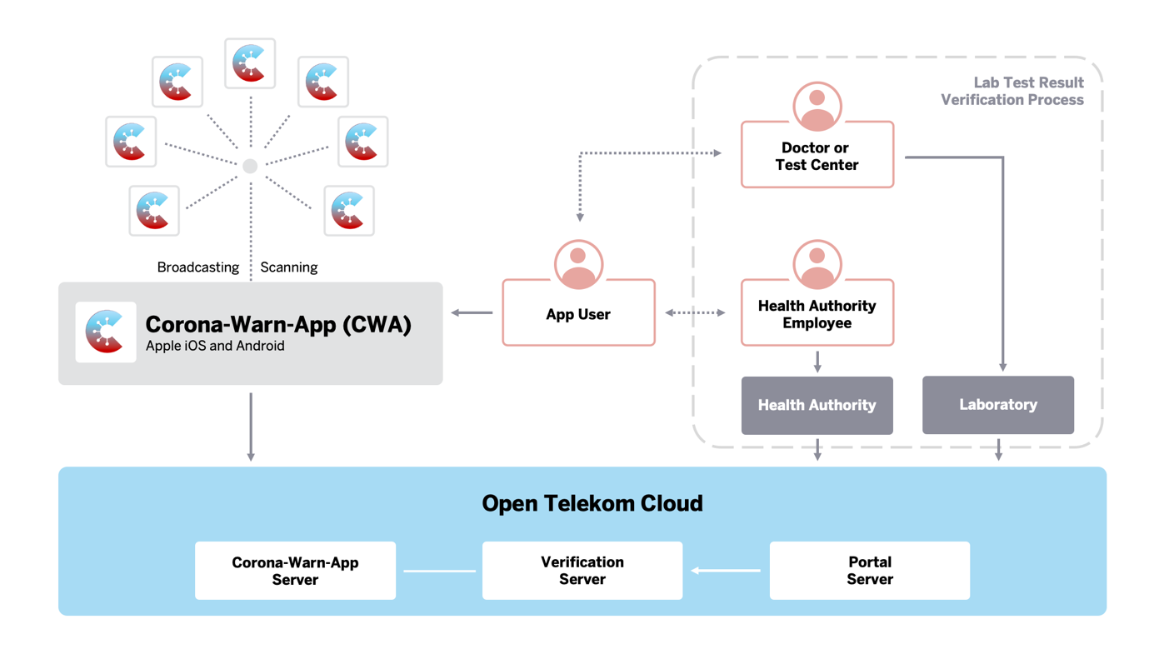
COVID-19 TRACKER USE CASE
Introduction
Contact Tracing application for mitigating infection chains.
Existing solutions require smartphones for exchanging ID codes with other users via Bluetooth if in close proximity.
If tested positive from a COVID test, the user receives a code from their doctor which they need to enter on their app to notify the people they have recently encountered.
Image Source: SAP

Slide 25
COVID-19 TRACKER USE CASE
Objective
Track person encounters and determine infection risk for each person.
Known Infection
High Risk
Medium Risk

Slide 26
COVID-19 TRACKER USE CASE
Challenge
Can Graph Databases assist Contact Tracing?
Contact Tracing is the search for events when people meet
People are interconnected through encounters like a social network.
SPARQL Path Search Capabilities
Calculates potential risk encounters in a single SPARQL query.
High scalability
Optimized for processing relations in large networks of data.

Slide 27
COVID-19 TRACKER USE CASE
Graph DB Benefits
Graph Databases Save Development Time!
Built-In Arbitrary Depth Path Search
Allows to easily search for connections between people who have met
Openly Available Data Models
Schema.org has people, places and events already modelled
Easily Extendable
Flexibility allows to cover other diseases with different parameters as well

Slide 28
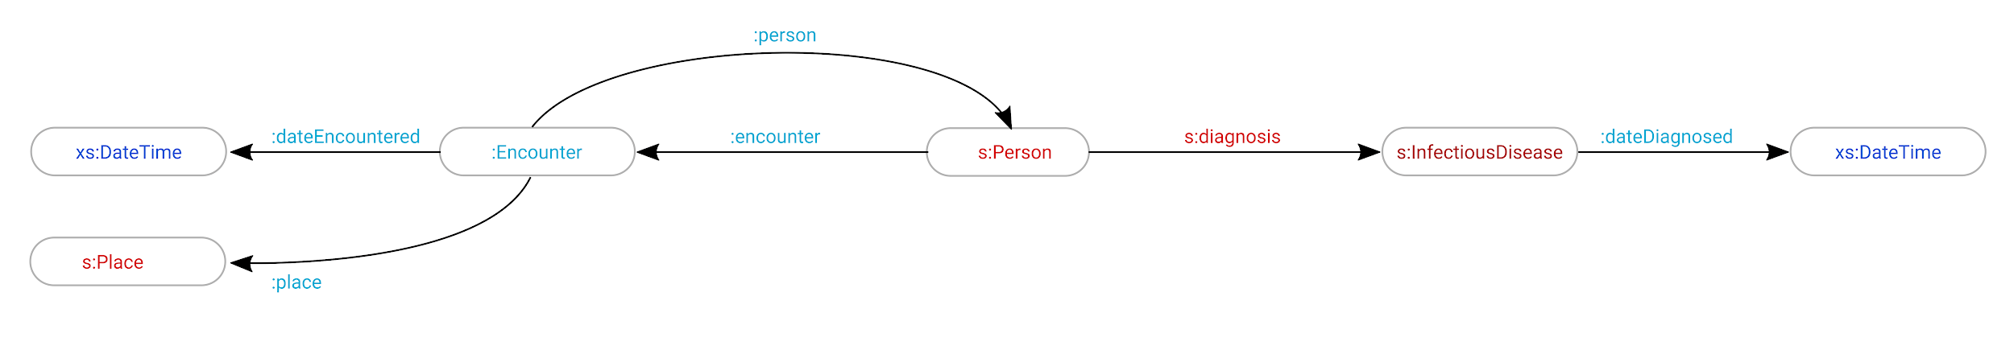
COVID-19 TRACKER USE CASE
RDF Data Model
Custom
schema.org
XML Schema
:encounter
Instance Layer
:You
:Encounter_XYZ
:DE_Augsburg
:person
:place
:is a
:is a
:is a
:encounter
Class Layer
s:Person
:Encounter
s:Place
:person
:place

Slide 29
COVID-19 TRACKER USE CASE
Identifying Infection Chains
:DE_Augsburg
:Encounter_1
:Andy
:Sebastian
:Encounter_2
:Somebody
:Stefan
A person is not endangered (‘No risk’) if:
they have no diagnosis
have not met anyone who is endangered
:Moritz

Slide 30
COVID-19 TRACKER USE CASE
Identifying Infection Chains
:DE_Augsburg
:Encounter_1
:Andy
:Sebastian
:Encounter_2
:Somebody
:Diagnosis_COVID
:Stefan
Somebody was diagnosed with an infection.
Moritz and Stefan are potentially endangered since you have a diagnosis after your most recent encounter with them.
:Moritz

Slide 31
COVID-19 TRACKER USE CASE
SPARQL Query for Risk Calculation
SELECT ?person ?hasDiagnosis MAX(?hasPotential) AS ?riskPotential
WHERE
{
?person a crt:Person ; crt:encounter / crt:person ?other .
FILTER(?other != ?person)
BIND(EXISTS { ?person crt:diagnosis ?diagnosis. } AS ?hasDiagnosis)
BIND(EXISTS { ?other crt:diagnosis ?diagnosis. } AS ?hasPotential)
}
GROUP BY ?person ?hasDiagnosis

Slide 32
Live Demo.

Slide 33
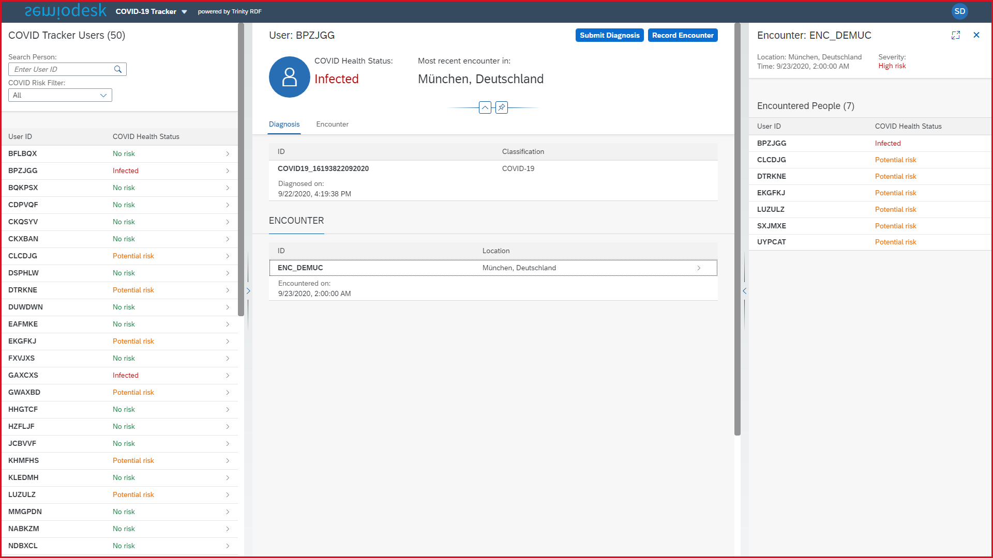
LIVE DEMO
Switching to Demo App

Slide 34
Technical Background.

Slide 35
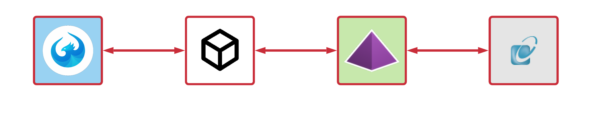
TECHNICAL BACKGROUND
System Architecture
Component | Technical Challenge | Architectural Solution
OpenUI5 Frontend - OData | Limited OData v4 Support | Fetch API to OData Microservice
OpenUI5 Frontend - ODataModel | No direct usage of OData v4 | JSONModel for storing fetched entities
OData v4 Client Microservice | Means to process OData queries | o.js library
ASP.NET Core Backend | Harmonizing Trinity RDF and OData | Encapsulating Trinity RDF

Slide 36
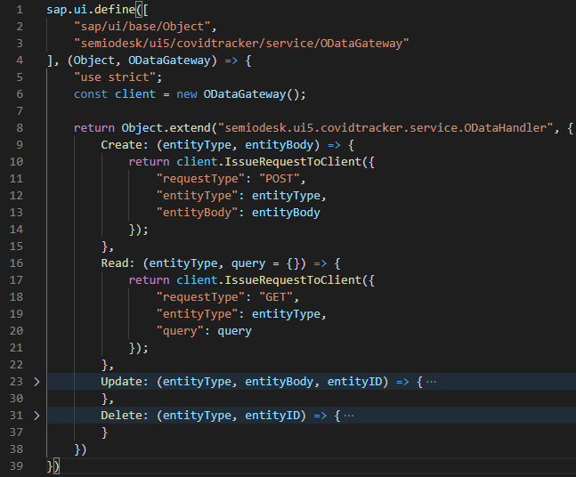
TECHNICAL BACKGROUND
UI5: OData Request Interface
To replicate some behavior of OData, a CRUD-based interface must be provided.
It uses an ODataGateway instance for providing the Fetch API abstraction which takes a JSON payload as parameter.
The JSON payload is isomorphic and adapts to the required parameters in o.js.

Slide 37
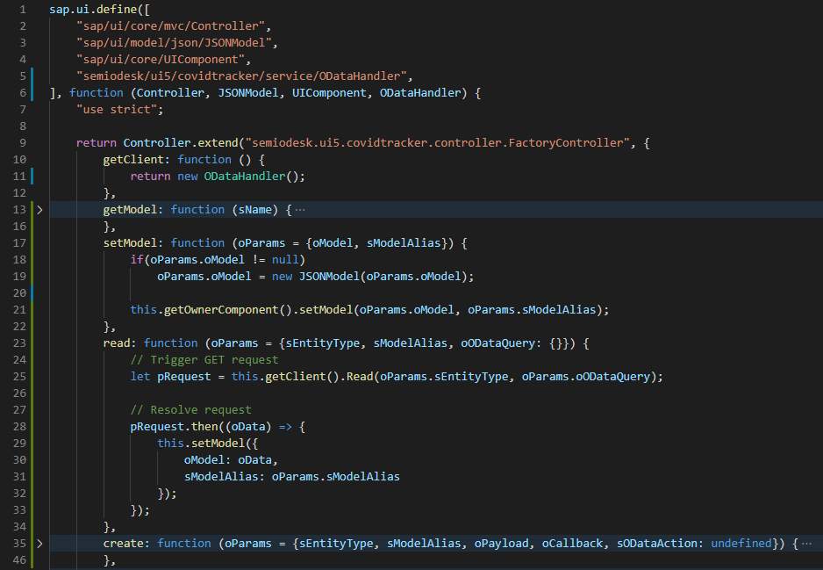
TECHNICAL BACKGROUND
UI5: From OData to JSONModel
The OData requests invoked by the BaseController have to be resolved for retrieving the entity.
In this case, the entity retrieved is stored in UI5’s JSONModel.
The functionality of storing data in JSONModel classes is abstracted in this controller.

Slide 38
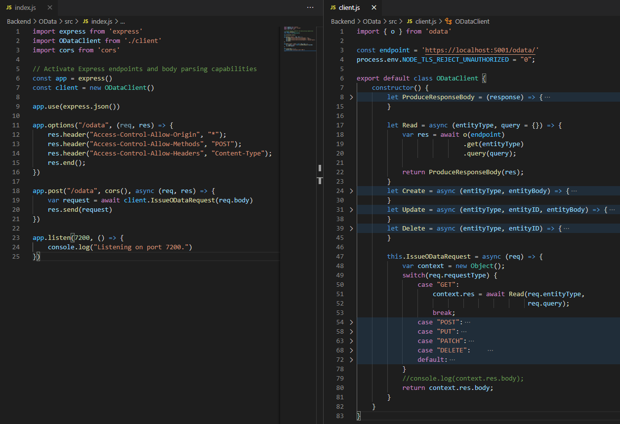
TECHNICAL BACKGROUND
OData V4 Client with o.js
This microservice serves as an OData V4 Client which is based on Express.js and o.js.
It takes some JSON payload as parameter and maps the request to the targeted OData service.
In other words, it takes the request from UI5 and forwards it to ASP.NET Core which in turn returns the result as a Promise.

Slide 39
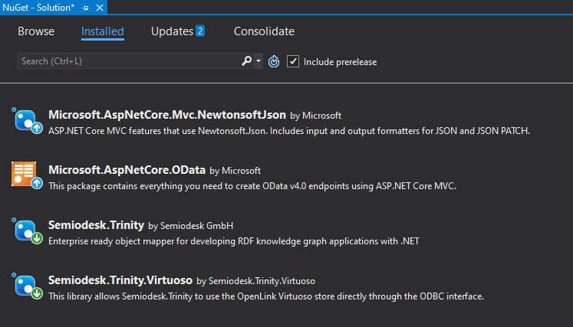
TECHNICAL BACKGROUND
C#: External Dependencies
To enable Trinity RDF and OData for Knowledge Engineering and Object-Mapping purposes, the following dependencies need to be installed via NuGet Package Manager.

Slide 40
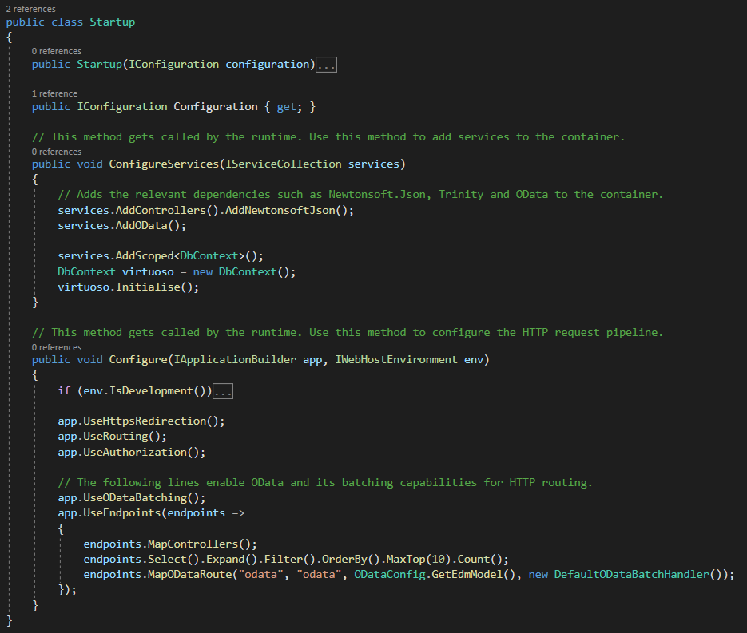
TECHNICAL BACKGROUND
C#: Dependency Injection
The Startup class is an important element in an ASP.NET Core application as it is responsible for binding external dependencies to it.
Inside this class, Trinity RDF, OData and Newtonsoft.Json need to be added.

Slide 41
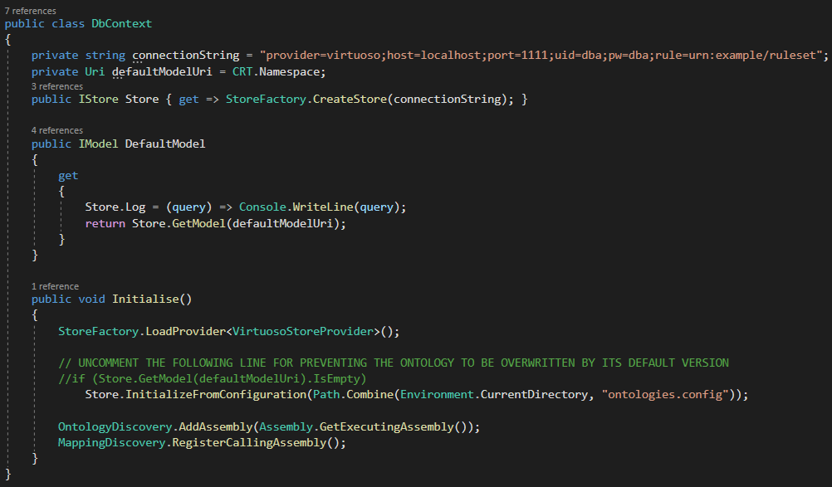
TECHNICAL BACKGROUND
C#: Trinity RDF Configuration
The Startup class uses the DbContext class for initializing Trinity RDF.
It contains the base configuration as to how Trinity RDF should be launched.
Other databases such as Stardog can be used with Trinity RDF.

Slide 42
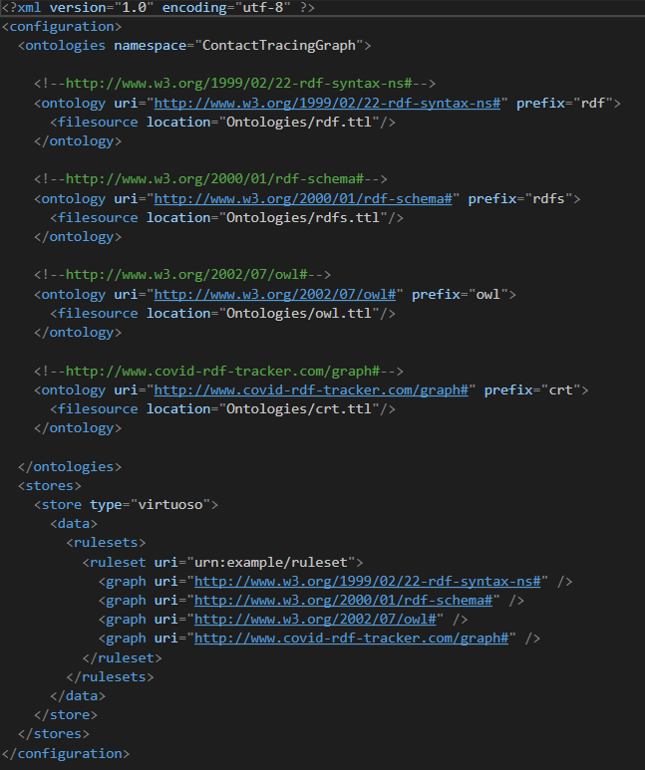
TECHNICAL BACKGROUND
C#: Referencing Ontologies
For enabling the Object-Mapping capabilities of Trinity RDF, an ontologies.config file must be created.
It references the file location of every Ontology inside the Ontologies folder which must be located in the project root.
Trinity RDF automatically creates the vocabulary from every Ontology as Ontologies.g.cs which can be reused across the entire application.

Slide 43
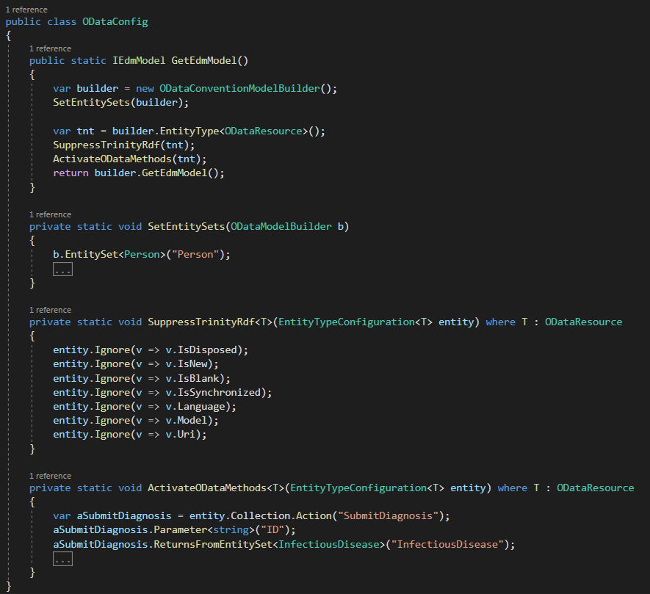
TECHNICAL BACKGROUND
C#: OData Configuration
The Startup class uses the ODataConfig class for enabling OData routing with MVC.
SetEntitySets() binds Model classes to the EDM (Entity Data Model).
ActivateODataMethods() enables OData Functions and Actions.
SuppressTrinityRdf() ensures that OData and Trinity RDF can harmonize together.

Slide 44
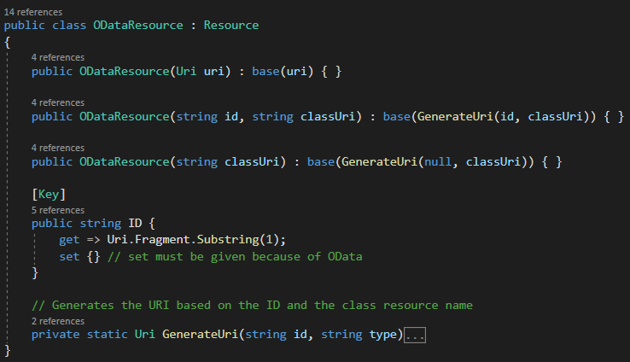
TECHNICAL BACKGROUND
C#: Object-Mapping with OData
In OData, each Entity must contain a [Key] annotated property, i.e. an ID.
In Trinity RDF, each Entity must inherit from the Resource class.
Since the Resource class has no ID but a URI only, an ODataResource class inheriting from it will be used where the URI’s Fragment Identifier will be used as ID instead.

Slide 45
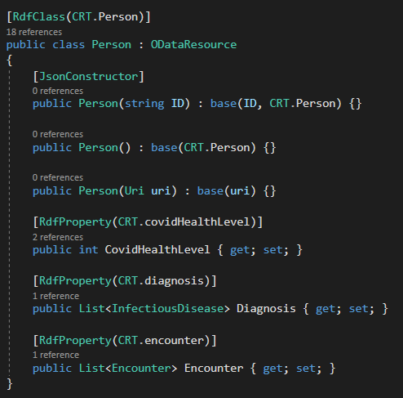
TECHNICAL BACKGROUND
C#: Entity Modelling
Any Entity must inherit from ODataResource for Trinity RDF.
The [Rdf] annotations for class and properties allow Trinity RDF to map the data retrieved from the data store to the relevant class instance.
Each annotation property takes the stringified URI of the data property as parameter. These can be referenced from the Ontologies.g.cs class.

Slide 46
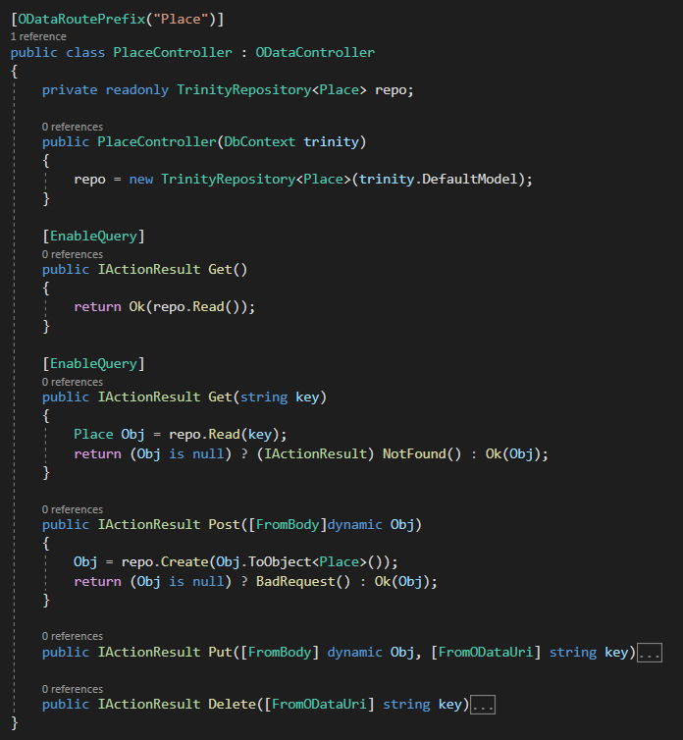
TECHNICAL BACKGROUND
C#: Designing Entity Controller
To build APIs for some Entity in OData, their Controller classes must inherit from the ODataController class.
Each ODataController is annotated with an [ODataRoutePrefix].
The [EnableQuery] annotation enables querying with OData.
This Controller encapsulates Trinity RDF entirely with the Repository Pattern.

Slide 47
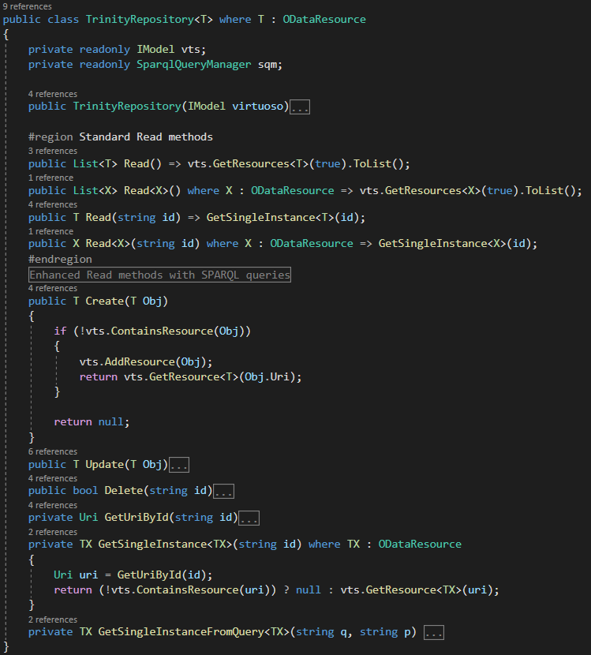
TECHNICAL BACKGROUND
C#: Repository Pattern
The DB persistence in Trinity RDF is abstracted with the Repository Pattern in order to promote code reusability and single responsibility.
This pattern ensures that the same code is not duplicated across all the Controller classes.
Using Generics, it is possible to represent some Template classes with any ODataResource class.

Slide 48
Conclusion.

Slide 49

CONCLUSION
Takeaways
Implemented the app in record time
Even with OData V4 work-around
...
Graph Database made backend implementation simple..
No need to implement graph search
...
Re-Using open ontology saved time
No considerable data modelling efforts
~1day
Implementation Time

Slide 50
CONCLUSION
Statistics
Component | Technology | Skill Level | Development Time (in min.)
Frontend - OpenUI5 | OpenUI5 (JavaScript) | Entry | 180
Backend - OData V4 Client | Node.js (JavaScript) | Advanced | 20
Backend - Linked Data Server | ASP.NET Core (C#) | Advanced | 60
Total Development Time (in minutes) |  |  | 260
It took about 4 hours and 20 minutes to deliver the architected solution.
OpenUI5 was developed with VS Code instead of SAP Web IDE.
Breaks have not been considered for this measurement.
Skill level also determines pace of development.

Slide 51
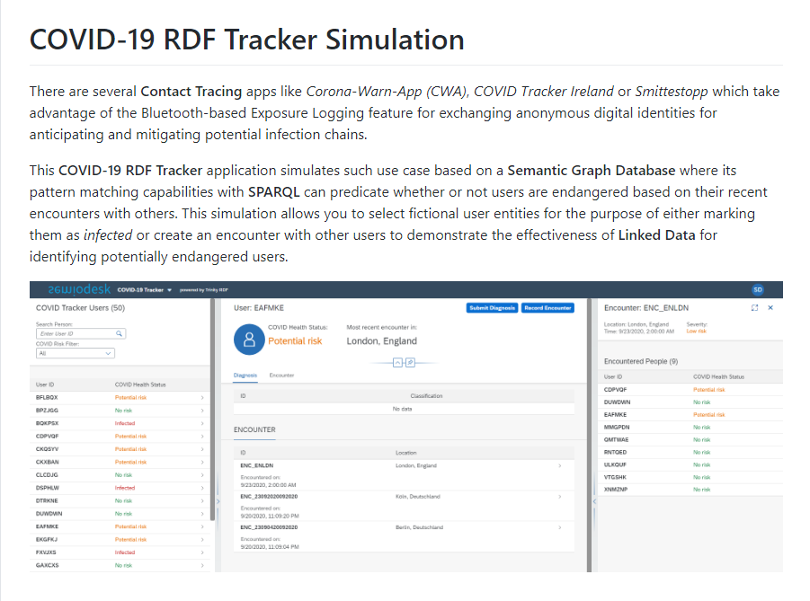
CONCLUSION
Our server is your server!
By reusing our provided solution, you don’t need to configure OData and Trinity RDF from scratch.
You only need to plug in your ontology and design the Entity and their Controller classes and run the backend.
You will save significant amount of development time on the Linked Data server. Even less than 20 minutes!
The entire application can be downloaded from GitHub.

Slide 52
Questions?
Download the demo app here:
https://github.com/andyle13/semiodesk-ui5-trinityrdf-contacttracing
Contact us to talk about your projects:
Stefan Summesberger
Head of Business Development
stefan@semiodesk.com
https://semiodesk.com

Slide 53
Thank you!

